Slide 1

Automagic venetian Blinds
Team Derp derp

Slide 2
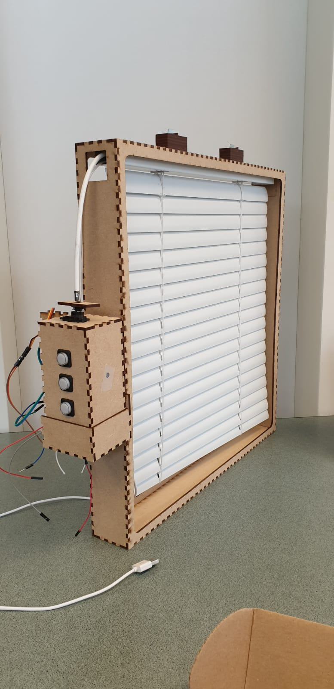
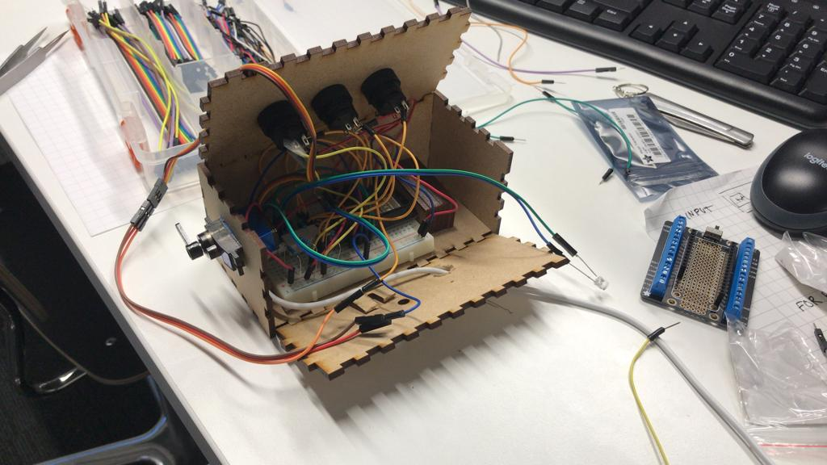
What is done

Slide 3
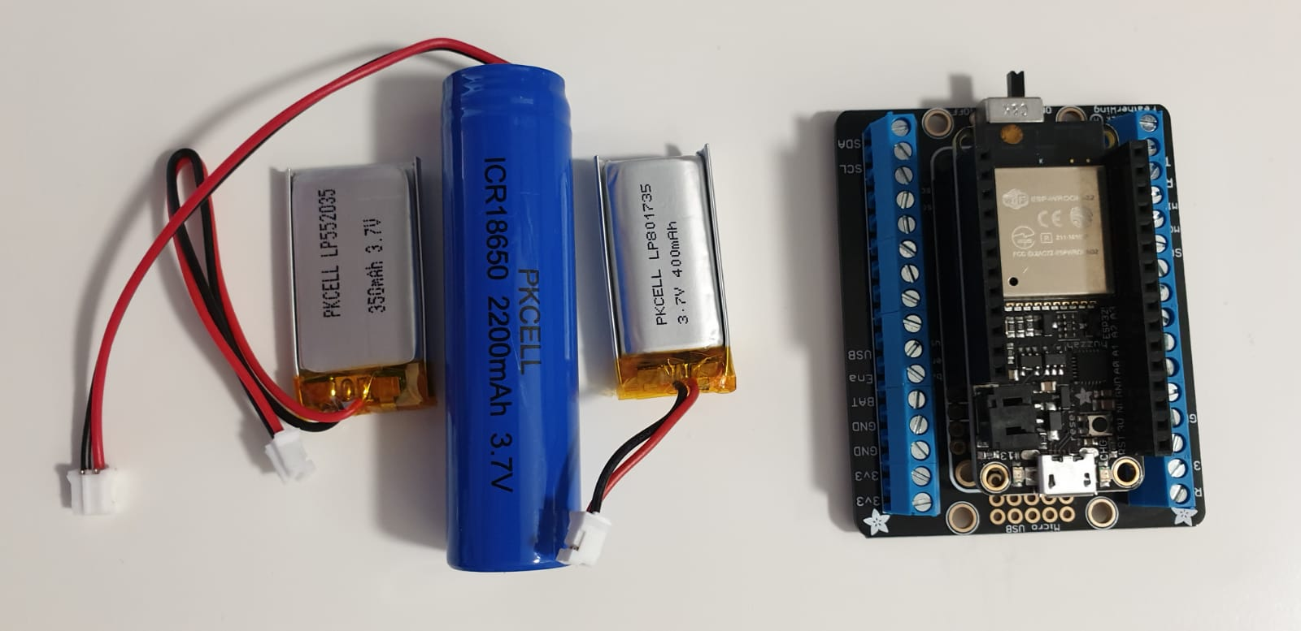
What is still pending
Use a single power supply (a LiPo battery) to power both the board and servo

Slide 4
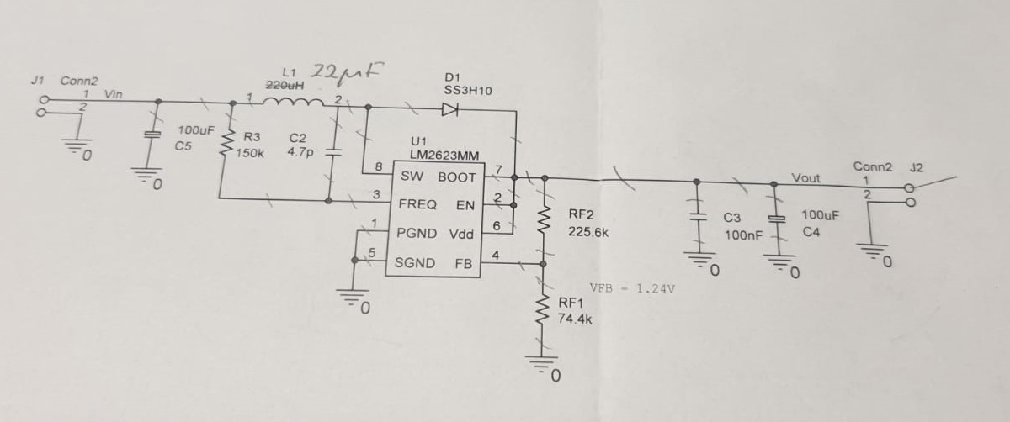
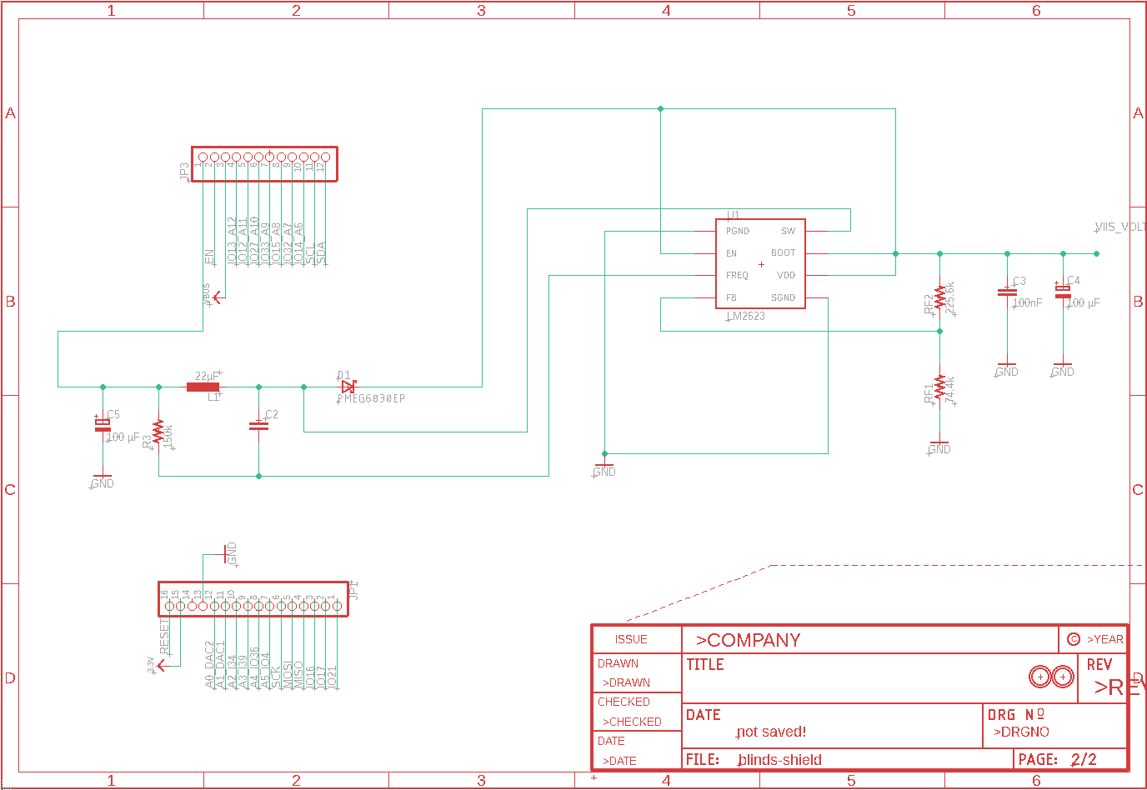
What is still pending
Fabricate a shield that contains a dc-dc converter to up the voltage from the boards 3.3V to the 5V required for the servo

Slide 5
What is still pending
Fabricate a second shield for the buttons, photoresistors and leds

Slide 6
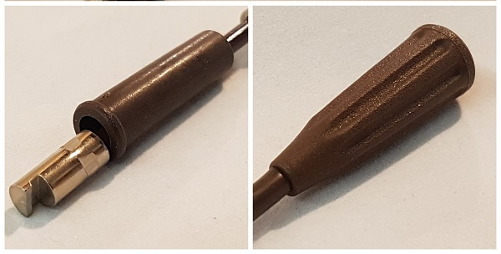
What is still pending
Fabricate a better chassis
Fabricate a connector for the servo to the blinds rod

Slide 7
Main challenges
Finding time to work. Team members are employed.
Had to learn basics of electronics. Still a work in progress.
Initial breadboard test with the servo ran into a common ground problem which took time to realize.

Slide 8
Super excellent course!!! The best blinds EVA!!

